Slide 1
AR 670-1 + Grooming and Appearance
Announcement
26 January 2021
HQDA G1 Uniform Policy Branch
SGM Brian Sanders

Slide 2
Bottom Line Up Front
AR and DA PAM 670-1 have been updated to reflect changes in uniform policy and procedures since 25 May 2017. The Army routinely examines our policies to ensure they meet the needs of the force. This is another way we are working to improve the lives of our force by putting people first.
The revision will provide guidance on new uniforms such as the Army Green Service Uniform (AGSU) and the Improved Hot Weather Combat Uniform (IHWCU). Also, transitions the Army from the Universal Camouflage Pattern to the Operational Camouflage Pattern for the Army Combat Uniform. These are items are extremely important the force as the regulation will not only provide guidance but assist with pure education of the uniform holistically.
Immediately following the effective date of AR and DA PAM 670-1, the Army will provide the ALARACT for grooming and appearance modifications. These approved changes reflect diversity, inclusion, health wellness, functionality, good order and discipline. These changes are extremely important to the force and aligns with the Chief of Staff of the Army’s People First priority.

Slide 3
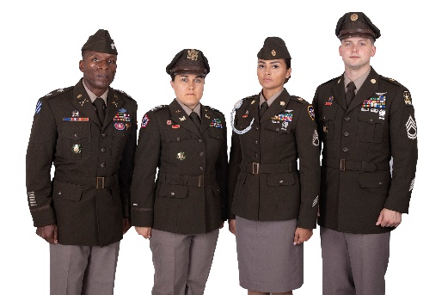
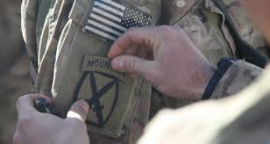

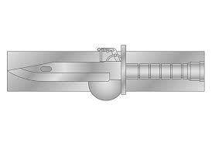

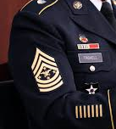
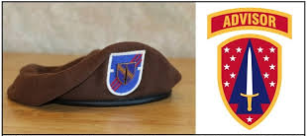
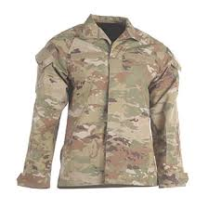
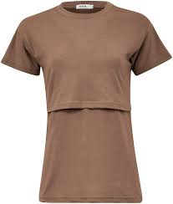
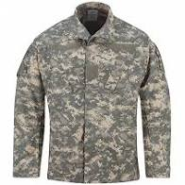
Significant Changes in AR and DA PAM 670-1
Implements policy for the new Army Green Service Uniform (AGSU).
Changes Shoulder Sleeve Insignia – Former Wartime Service (SSI-FWTS) to Shoulder Sleeve Insignia – Military Operations in Hostile Conditions (SSI-MOHC).
Establishes Expert Soldier Badge, Master Gunner ID Badge, and Military Horseman ID Badge.
Establishes and adds guidance for the Senior Enlisted Advisor to the Chairman of the Joint Chiefs of Staff (SEAC) grade insignia.
Adds guidance for SFAB wear of the shoulder sleeve insignia and SFAB unit’s wear of the Brown Beret.
Implements the Improved Hot Weather Combat Uniform as an authorized item.
Authorizes female Soldiers who are breastfeeding or pumping to wear an optional undershirt.
Removes references to Universal Camouflage Pattern (UCP)

Slide 4
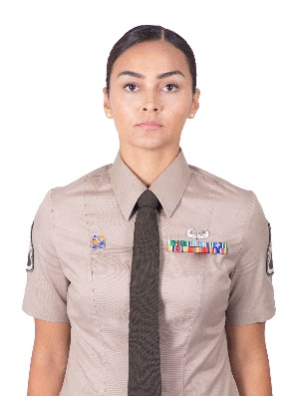

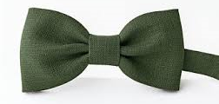
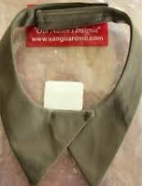
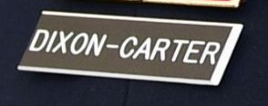
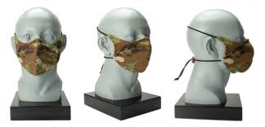

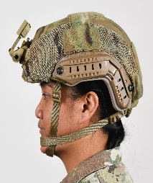
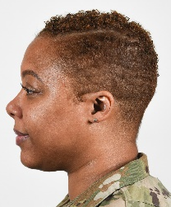
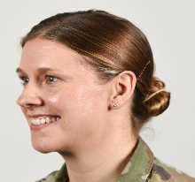
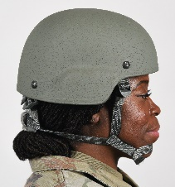
Changes NOT included AR and DA PAM 670-1
AGSU Tropical Dress Variation and Class B optional wear of Insignia and Accoutrements.
Establishes and provides wear guidance for non-subdued National Guard Identification Badge (NGIB). (Policy Memo completed May 2020).
Bow Ties and Neck Tabs for the AGSU Dress Variation – pending development of the Neck tab (Currently being developed by NATICK).
Authorizing diacritical accents and hyphens to Soldier’s last names on Name tapes and Nameplates for Army uniforms. (Approved by the SEC 8 OCT 2020).
SSI-MOHC authorization for Saudi Arabia. (Policy Memo completed 18 JUN 2020).
Guidance on Combat Cloth Face Coverings (CCFC) (Black and Coyote). Still pending development by DLA.
Grooming and Appearance modifications (Approved 11 DEC 2020). Policy will be released immediately following the effective date of AR and DA PAM 670-1 with Army approved imagery to accompany the guidance distributed to the Army.
*These items including future items will be placed in the next revision* revision.

Slide 5
Review Panel / SME Team
Headquarters, Department of the Army (HQDA)
U.S. Army Reserve Command (USARC)
U.S. Army National Guard (ARNG)
U.S. Forces Command (FORSCOM)
U.S. Training and Doctrine Command (TRADOC)
U.S. Army Special Operations Command (USASOC)
U.S. Army Recruiting Command (USAREC)
U.S. Army Futures Command (AFC)
Office of the Surgeon General (OTSG)
Defense Logistics Agency (DLA)
Defense Health Agency (DHA)
Walter Reed National Military Medical Center
Female Breakdown
Male Breakdown
Other Data
2 x GO
1 x COL
1 x MAJ (SME-Psychologist)
1 x CPT (Ranger)
1 x CW5
2 x Nom CSM & 2 x SGM
3 x SFC (1 x Recruiter)
1 x SSG (Drill Sergeant)
2 x E5
1 x LTC (SME-Dermatologist)
1 x LTC (SME - Dermatologist)
1 x Nom CSM (Corps CSM)
1 x SGM
1 x SGM (SME-EOA)
Age range: 24 to 55yrs old
Average age: 44 years old
Career Management Fields: SF, IN, AR, MC, MP, PA, OD, FI, AG, PO, LG
Special Skills: Military Free Fall, Airborne, Ranger, Pathfinder, and Air Assault.
Special Duty Assignment Personnel: Recruiter and Drill Sergeant

Slide 6
Mission – Purpose – End state
Mission: HQDA G1 Uniform Policy Branch provided proposed modifications to grooming and appearance standards. Subject matter experts presented findings and recommendations to the review panel.
Purpose: The review panel discussed the proposed modifications and findings, voted and assisted in shaping the appropriate recommendations based on but not limited to professional appearance, health and wellness, functionality, good order and discipline, diversity, and inclusion.
End State: The recommendations made by the review panel reflect a progressive Army, the Army’s image and values and the Army’s commitment to diversity and inclusion.

Slide 7
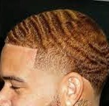
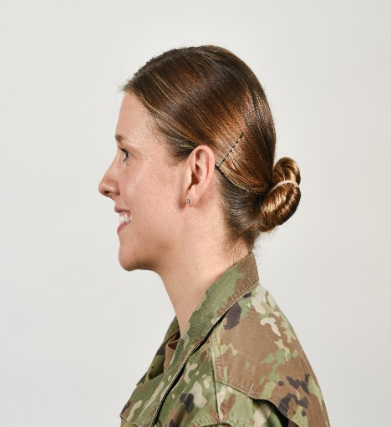
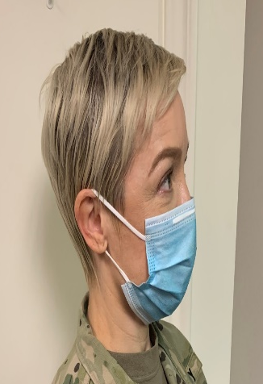

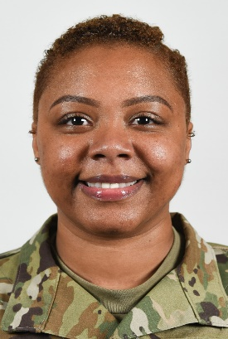
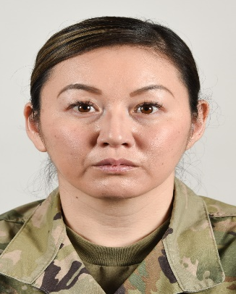
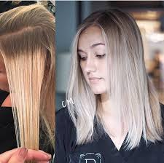
Highlights (Uniform Blend Colors)
Amend para. 3-2(a)(1)(b) to state that hair color should not be a color that is extreme & must present a natural appearance. Highlights (Uniform Blend of Colors) are authorized. If a Soldier decides to add color or highlights to hair, root growth of a different color should not exceed 1.5 inches of the original color.
Panel was in favor of authorizing highlights (uniform blend of colors) as long as it presents a natural appearance (Natural Hair Colors) and is not a prohibited color such as but not limited to purple, blue, pink, green, orange, bright red, and fluorescent or neon colors.
Recommended by the panel to make this “gender neutral” as some men use hair dyes.

Slide 8
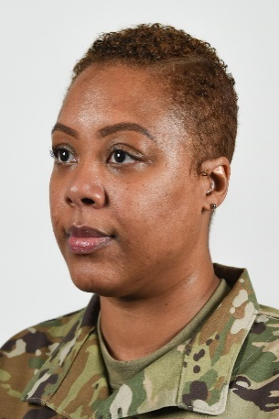
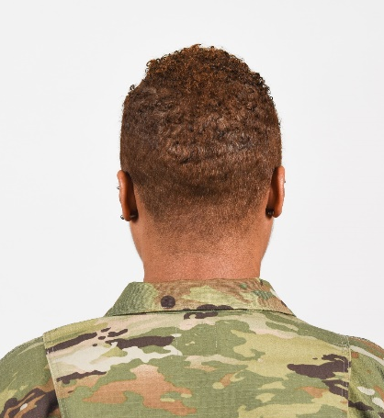
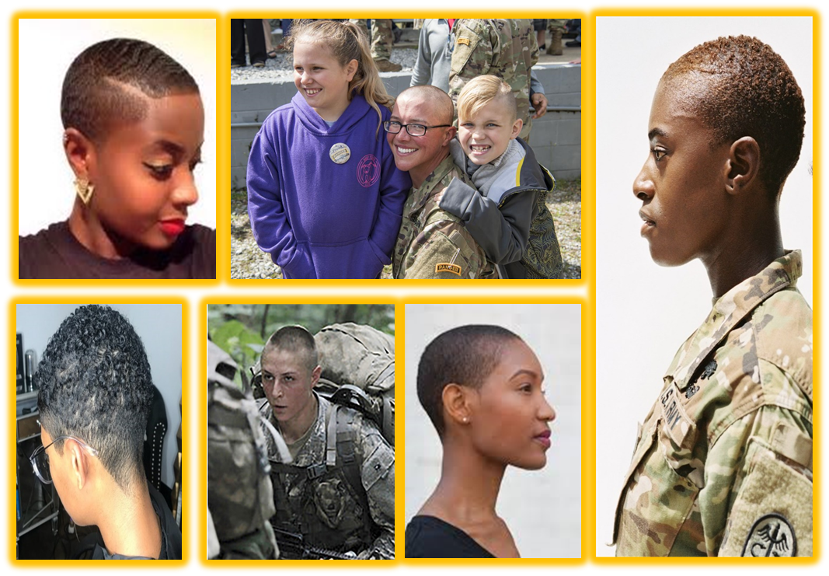
Minimum Hair Length
Amend Para. 3-2(a)(3)(a) to specify no minimum hair length for female Soldiers.
Panel in in favor of recommendation and want to ensure female Soldiers may taper the hair and add a part in the hair as an option.
AR 670-1 currently authorizes Soldiers who are not able to naturally part the hair the option to cut a part into the hair or style the hair with one part. The part will be one straight line, not slanted or curved, and will fall in the area where the Soldier would normally part the hair.

Slide 9
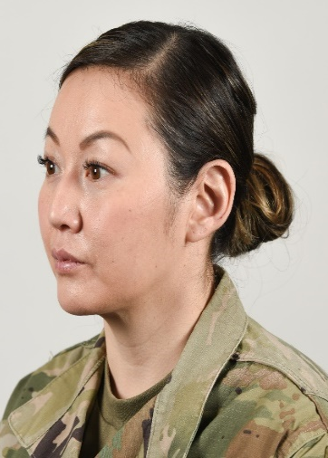
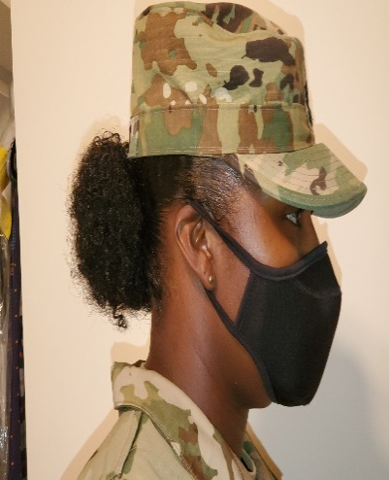
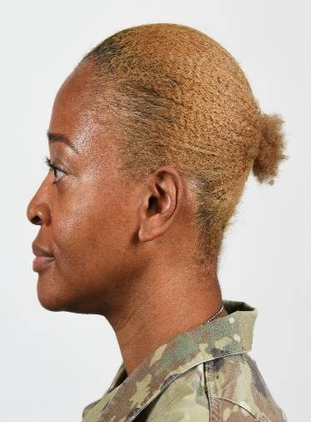
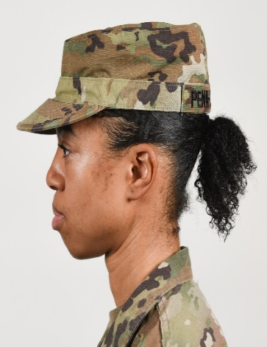
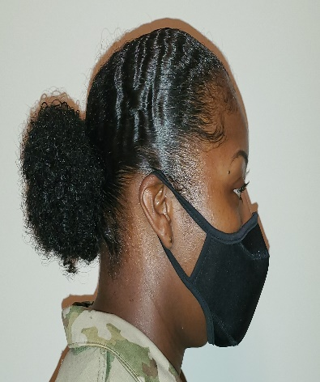
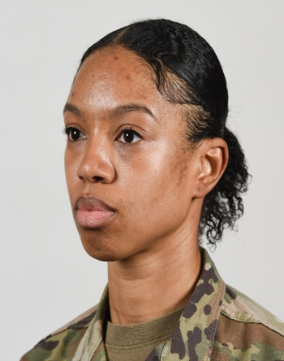
Short Ponytail
Amend para. 3-2(a)(3)(b) to add that some female Soldiers are unable to create a bun due to the length and/or texture of their hair, and allow them to place into a ponytail.
Panel in favor of authorizing a ponytail for female Soldiers whose length and/or texture of hair doesn’t allow them to place into a bun. The unsecured hair will be worn in the back of the head and will not interfere with the proper wear of the headgear.

Slide 10

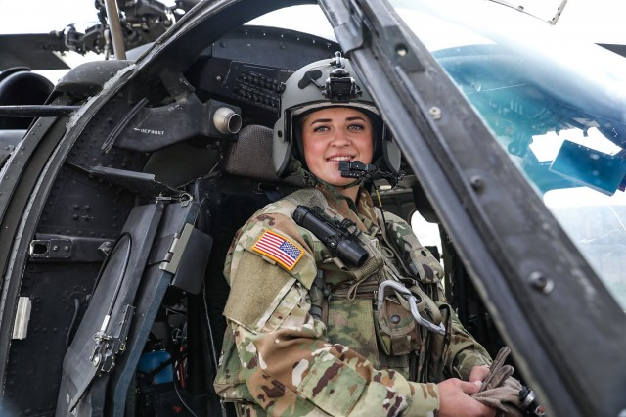
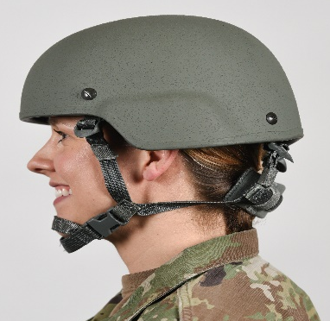
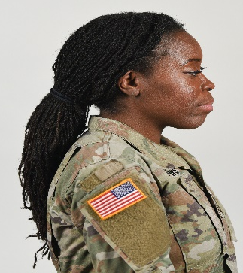
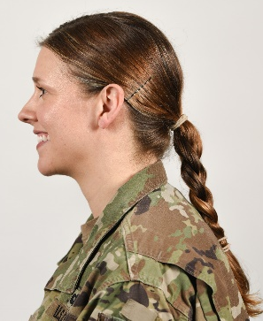
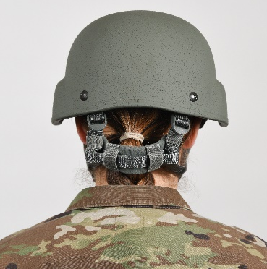
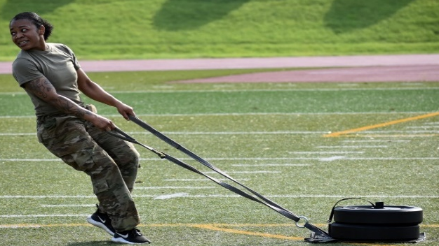
Long Ponytail
Amend para. 3-2a.(3)(c, d, & j) such that long hair ponytails are allowed in utility uniforms when conducting physical training, or wearing tactical equipment such as but not limited to the Advanced Combat Helmet (ACH) or Combat Vehicle Crewman Helmet (CVC).
Panel in favor of recommendation as long as the hair is secured inside the ACU top while conducting tactical training or combat operations.

Slide 11
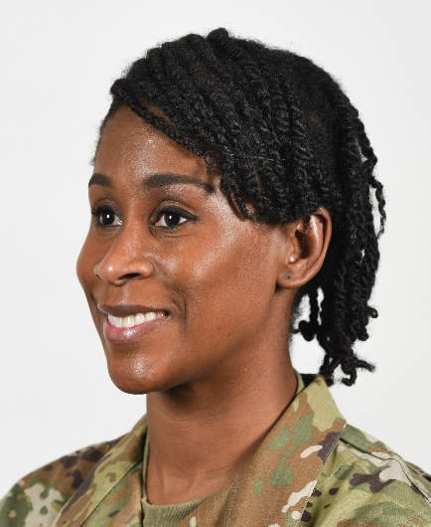
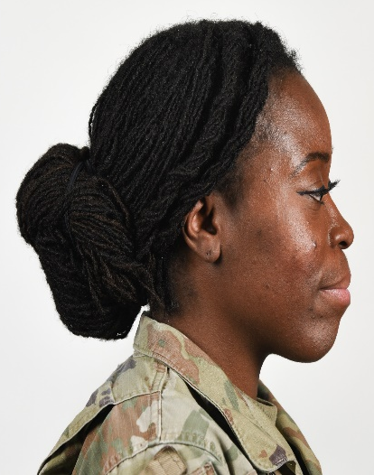
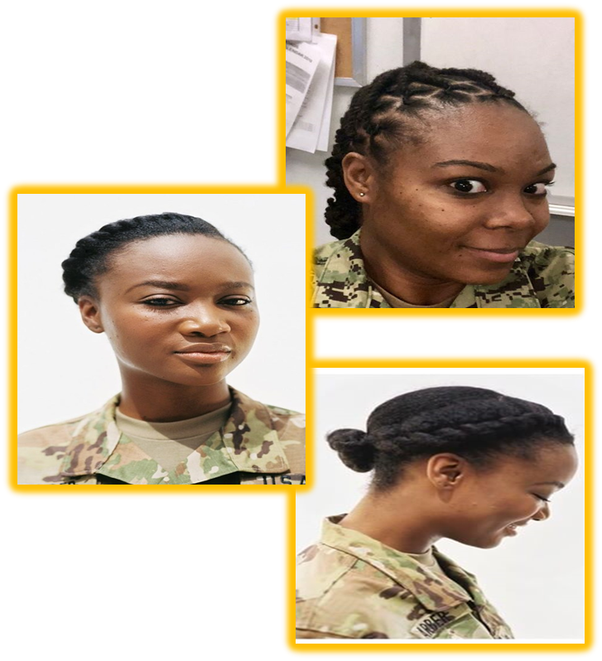
Multiple Hairstyles
Amend para. 3-2a.(3)(f), such that two hairstyles may be worn at once, for example, locs or twists can be braided or twisted to the scalp.
Panel in favor of authorizing “multiple” (do not limit by # of) hairstyles worn at once as long as it is neat in appearance and doesn’t impact the wear of uniform and equipment. Provide imagery of what we are allowing in regard to multiple hairstyles.
Recommend altering/removing verbiage on dimensions of braids and cornrows (example: Each must have the same approximate size of spacing between the braids, cornrows, twist or locs). This will allow flexibility in neatly styling the hair.

Slide 12
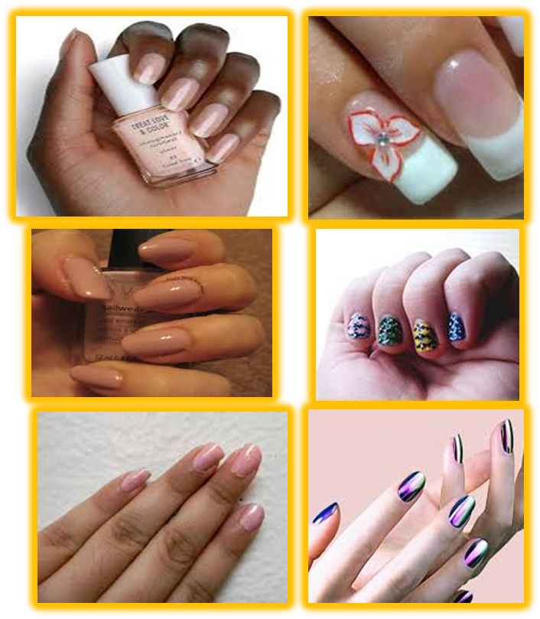
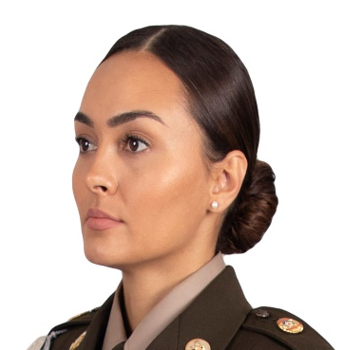
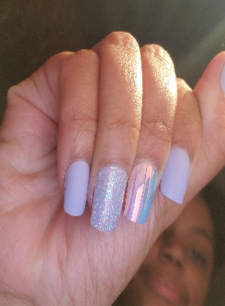
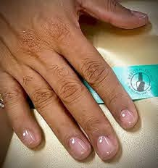
Lipstick/Nail Polish
Amend 3-2 b.(3) & c. to state Females will not wear shades of lipstick and nail polish that are extreme and present a professional appearance.
Panel in favor of authorizing shades of lipstick and nail polish that are NOT extreme. Extreme colors include, but are not limited to: purple, gold, blue, black, white, bright (fire engine) red, hot pink, yellow, and fluorescent/neon colors. Prohibit shapes that are considered extreme such as coffin, ballerina, and stiletto. Also, allow American manicure for female Soldiers.
Panel also in favor of authorizing male Soldiers to wear clear nail polish to assist with maintaining a well-groomed appearance and to assist with maintaining healthy nails, especially for male Soldiers’ hands that are constantly exposed to harsh chemicals.

Slide 13
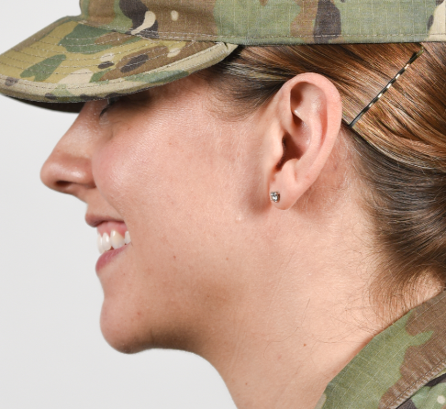
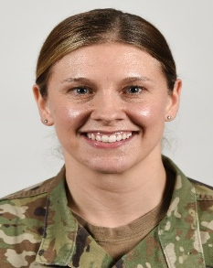
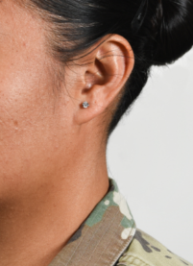
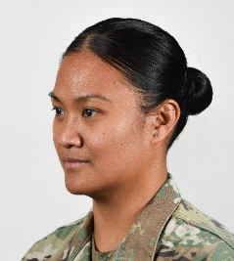
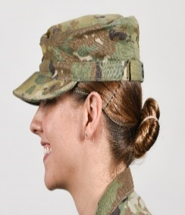


Earrings
Amend para. 3-4(d) to authorize female Soldiers to wear earrings in the Army Combat Uniform (ACU). This will be optional for the Soldier and not worn in a deployed or field environment.
Panel in favor of authorizing the optional wear of earrings for female Soldiers in the Army Combat Uniform (ACU).
Only in Garrison; commanders will determine if earrings can be worn if it increases the risk of a safety hazard.
Not in a field environment, tactical training or combat deployments.

Slide 14


Remove Offensive Wording
Remove the Following words in AR 670-1:
“Fu Manchu” and “Mohawk” - the mohawk hairstyle takes its name from the people of the Mohawk nation. Fu Manchu has been considered offensive to Asian Culture.
“Dreadlocks” and change to “Locs”, the term dreadlocks has ties to the American Slavery experience.
“Eccentric” and “Faddish”, these words seem to target a specific demographic. The words “Extreme” and “exaggerated” are sufficient when describing violations to the Grooming and Appearance Standard.
“Discretion of the commander” and “professional” are a subjective phrase and term, but can be mitigated through education of the regulation, visual representations, color swatches, and familiarity of hair styles and textures.
Panel in favor of removal of potentially offensive/weaponized wording such as Mohawk, Fu Manchu, Dreadlock, Eccentric, and Faddish and replace with alternative verbiage. Adding clarity on wording/phrases such as professional appearance and provide guidance such as “based on safety, good order, and discipline” instead of solely relying on the phrase “At the discretion of the commander”.

Slide 15







Update Imagery
Recommend updating current imagery and adding detailed images to assist Soldiers and Leaders.
Panel in favor of adding imagery to equip the Army with specific examples for standards in regard to grooming and appearance. Provide specifics on what right and wrong looks like.
Recommended verbiage for the examples – “Not all encompassing, this is to provide a general overview”.

Slide 16

Questions

Slide 17
BACK – UP SLIDES

Slide 18
Agenda - Topics
Review Panel / SME Team Breakdown
Mission – Purpose – End state
  1. Amend para. 3-2a.(1)(b) to authorize Highlights (Uniform Blend of Colors) (Gender Neutral)
  2. Amend Para. 3-2a.(3)(a) to specify no minimum hair length for female Soldiers.
  3. Amend para. 3-2a.(3)(b) to add that some female Soldiers are unable to create a bun due to the length and/or texture of their hair, and allow them to place into a ponytail.
  4. Amend para. 3-2a.(3)(c, d, & j) to allow long hair ponytails while wearing tactical headgear.
  5. Amend para. 3-2a.(3)(f) to allow multiple hairstyles worn at once
  6. Amend 3-2b.(3) & c. to authorize lipstick and nail polish.
  7. Amend para. 3-4(d) to authorize female Soldiers to wear earrings in the Army Combat Uniform (ACU). **Not in Field Environment**
  8. Removal and replacement of offensive/weaponized wording in AR 670-1.
  9. Add and update images with detailed specifics.

