Slide 1
How To Submit Local Voucher IDT Travel Reimbursement Program

Slide 2
Reimbursable Expenses for IDT Travel
Reimbursement is limited strictly to $500 of actual travel and transportation costs (tolls, train/bus/airplane expenses, rental car, lodging, parking, travel day meals)
Payment of mileage varies, but should be in the range of $.17 to $.23.
This is not the standard TDY mileage rate
Actual cost for travel day only meals, up to 75% of IDT location M&IE rate
Use of the LIK Program does not reduce the $500 limit, but Soldier may not be reimbursed for Lodging
The official distance a Soldier travels to their IDT location is determined by the Defense Table of Official Distances (DTOD) using Zip Code to Zip Code
Receipts are required for ALL expenses

Slide 3
Verify Distance in DTOD
Select “Distance Calculator”
Notes:
Do this first to ensure that you are over 150 miles away.

Slide 4
Verify Distance in DTOD
1. Enter Zip Code or Town and State,
then select “Search”
2. Select proper city/location
with zip code (if available)
3. Do the same steps for
“Traveling To:” 85008
Notes:
Do this first to ensure that you are over 150 miles away & remember this mileage for your vouchers.

Slide 5
Verify Distance in Distance Calculator
Ensure both “Traveling From:” and “Traveling To:” are correct
Select “Calculate Mileage”
IDT Reimbursement authorized for 150 miles and greater
Save this mileage calculation for the expense page
Notes:
If this shows that you are 150+ miles away then continue onto the next steps.

Slide 6
DTS Procedures
Manual vouchers will NOT be used to pay for IDT travel reimbursement
DTS local travel voucher will be completed for reimbursement
Substantiating documents required in DTS:
Receipts for all expenses
Redacted BA Sign in Roster or DA Form 1380 for RST
Commander’s Certification Memo
dd

Slide 7
DTS Procedures for IDT Travel Reimbursement
Click on “Create New Document” drop down Menu
Select “Local Voucher”

Slide 8
Create New Local Voucher
*CORRECTION
Local Voucher Date: *Enter the start date of Battle Assembly (not the first or last day of travel). Reference: “(month) BA – IDT TRP” Conference Attendance: “No”
Click “Continue”

Slide 9
Airline Travel
1
3
2
FOR Airline Travel
Select “Add Expense”
Select “Other Expenses”
Select “Other – Create Your Own”

Slide 10
Airline Travel
1
FOR Airline Travel
Click Attach Receipt (Cont.)

Slide 11
Airline Travel (Cont.)
FOR Airline Travel
Browse
Insert receipt file
Do not check box
Click “Select”
1
2
3
4

Slide 12
Airline Travel
FOR Airline Travel
Type in “Airline Ticket ” for Expense Name
Type in “Battle Assembly” for Purpose
Select date if not done for you
Add amount for airline ticket
1
2
3
4

Slide 13
Airline Travel Cont.
FOR Airline Travel
Verify Method of Reimbursement
Add notes if needed
Select “Add”
1
2
3

Slide 14
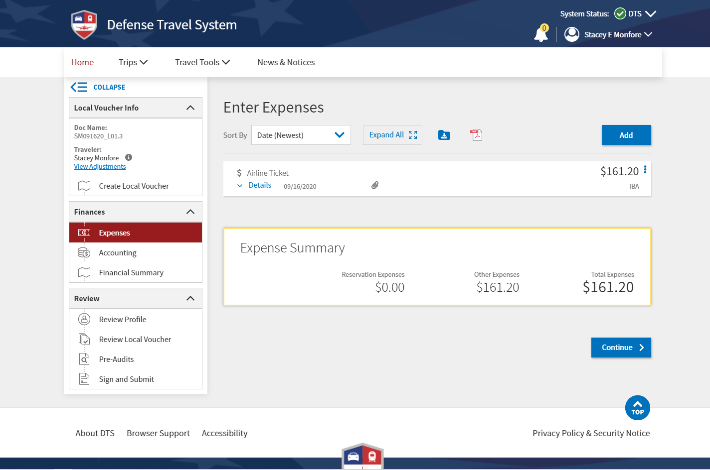
Expenses
Add other authorized IDT Travel Reimbursement expenses

Slide 15
Expenses
Add other authorized IDT Travel Reimbursement expenses
Select Type
Attach Receipt
Enter information
Click “Add”

Slide 16
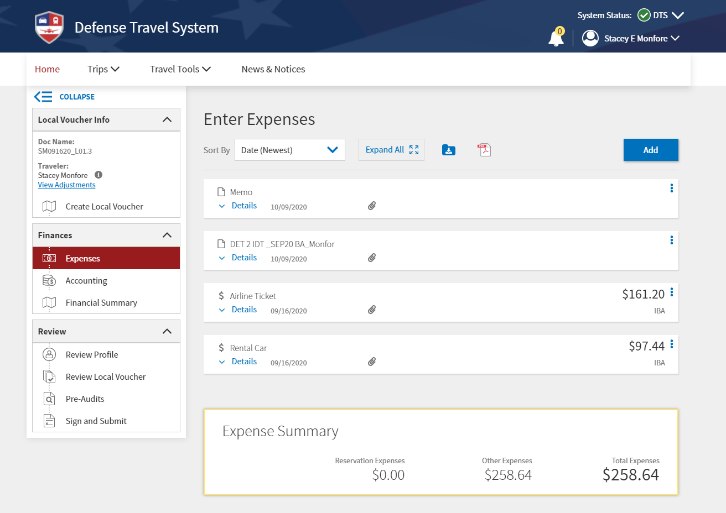
Add substantiating Records
Upload Substantiating Documents:
Receipts for all expenses (to include meals)
Signed DA 1380 (RST), or BA Sign In Roster
Commander’s Certification Memo
Signed DD 1351-2, if UA or FTS enters in for TPU Soldier

Slide 17
Add substantiating Records
Select “Browse”
Select document and click “Select”
Check the box “All pages”, or check document pages you want to upload
Click “Next”
Click “Documents”
3
1
5
4
2

Slide 18
Add substantiating Records
Select type of document
Input document name in “Document Name” and “Notes”
Click “Attach”
Click “Done”

Slide 19
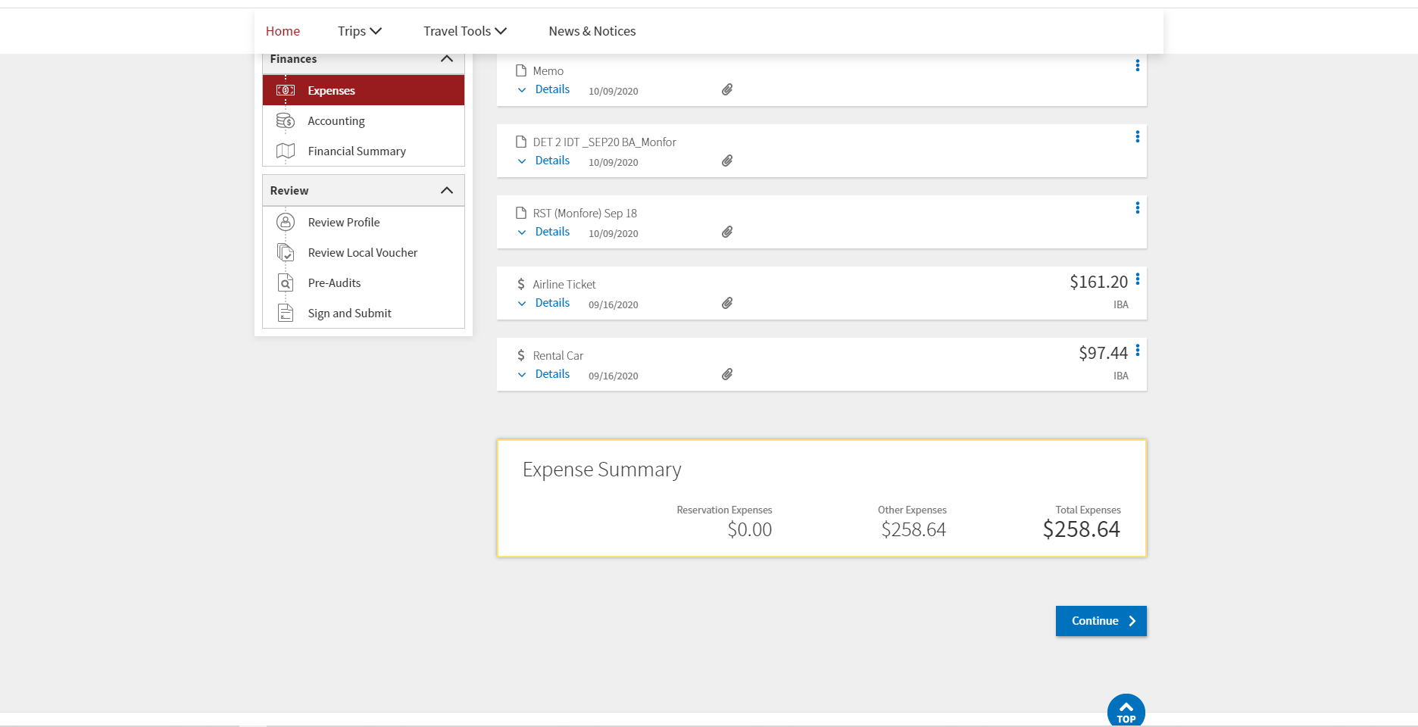
Add substantiating Records
Select “Continue”

Slide 20
Accounting
1
Accounting
Select “Add LOA”
Select “Cross ORG LOA”
Search “IDT”
Use FY23 (*update) -23 MIRC1BTPRE for Enlisted -23 MIRC1BTPRO for Officer
2
3

Slide 21
Set $500 Limit
TOTAL MUST NOT TO EXCEED $500.00

Slide 22
Input Comments
Add Required Comment: “IAW 37USC, 452 (b) (9), IDT TRAVEL OUTSIDE NORMAL COMMUTE (150 miles). Soldier is authorized travel expenses NTE $500 for travel to and from Inactive Duty Training according to JFTR, Paragraph U7160.” Select “Save”

Slide 23
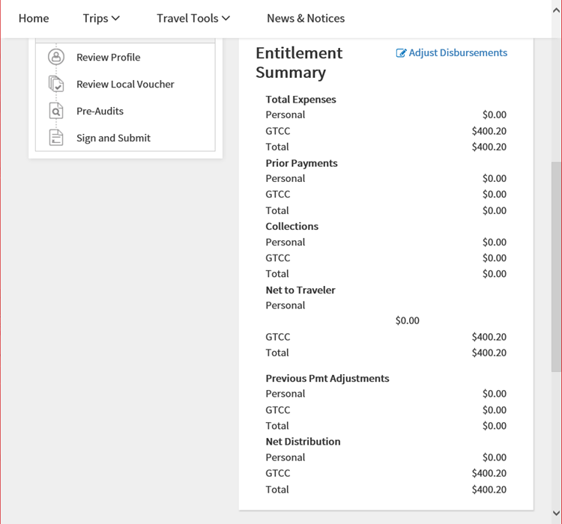
Verify total Amount
Ensure total expenses do not exceed $500.00

Slide 24
Justification
Add reason codes and comments for all Audits Add “(month) Battle Assembly” to justification to Approving Official and click “Save and Proceed To Digital Signature”

Slide 25
Digital Signature
Select ROUTING LIST – 301
Click I agree to SIGN this document
Digital Sign Travel Voucher – Click “Submit Completed Document”

